Slide 1
Academic approaches to TNE: developing competencies, enhancing delivery
Topic 7:
HUMAN PERSPECTIVES
Managing Strategically
Introduction to Management (ITM)
Prepared by Dr. Keith Toh

Slide 2
Human Perspectives
1.Foundations of Management practices
2. Managing OB: Foundations
Organisational Perspectives
6. Leadership
7. Managing strategically
8. Organisational analysis
International Perspectives
10.
Global society
11. Future Trends
3. Managing OB: Groups & teams
12. Review
4. Managerial communication
5. Managing ethical behaviour
9. Innovation, creativity & design
Introduction to Management

Slide 3
Aims of the lecture
Strategic Management
Strategy as a process
Context of Managing Strategically
As practice; As learning
Developing strategic management skills
Applying organisationally
Strategy models

Slide 4
Critical views and definitions…

Slide 5
Differing Views of Managing Strategy
Strategic Management
Increasing the likelihood of your product, technology, design or service delivering success and dominance in the market
How to disrupt your competitors through innovative business models
Harness human capital in process of innovation

Slide 6
Defining the Organisational Domain
Defining the organisation’s domain is a strategic matter
The organisational domain is about achieving a more balanced framework for identifying structural, social/historical, power/political and cultural issues.
What is within the organisation
What is external to the organisation (environment)

Slide 7
Organisational Domain
The traditional view was
a manager had to protect what was inside
create a stable organisational “environment”
What is within the organisation
Externalities
(environment)

Slide 8

Managing Strategically
The ability to seeing outside organisational boundaries

Slide 9
Strategic Management
Strategic management can be
process driven
Managing process
Managing “knowledge”

Slide 10
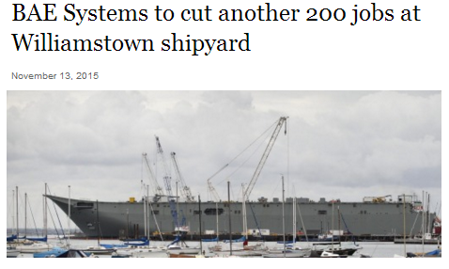

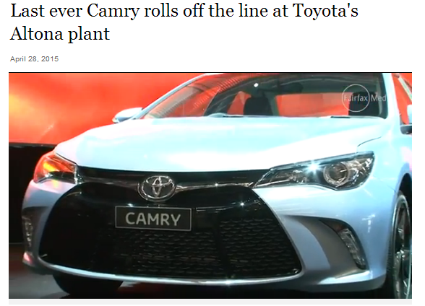
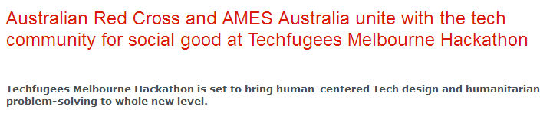

Slide 11
Origins of Strategy theories…

Slide 12

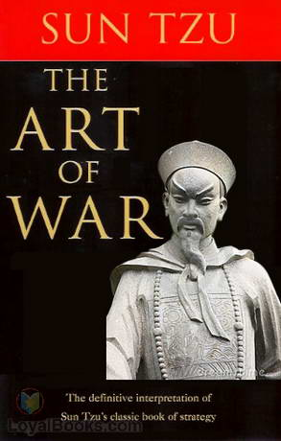
Michael Porter
Raymond E. Miles
Charles C. Snow

Slide 13
Overview of Strategic Management
Strategy as Process
Strategy as Tools
Strategy as Models
Macro Analysis
PESTEL
Generic Models
Political
Porter
Miles & Snow
Industry/Sector Analysis
Economic
Sustainability
Market Focus
Typology
Technology
Differentiation
Prospector
Organisational Analysis
- Resource Based View
Environment
Defender
Legal
Cost
Analyser
Reactor
Porter’s Five Forces of Competition
Strategic Dilemma
Threat of Entrants
Strategic Direction
Threat of Substitutes
Bargaining Power of Suppliers
Bargaining Power of Buyers

Slide 14
Strategy as Process
Macro Analysis
Environmental scan and information gathering
Industry/Sector Analysis
Organisational Analysis
Strategic Dilemma
Strategic Direction
Organisational Focus
Implementation and Control

Slide 15
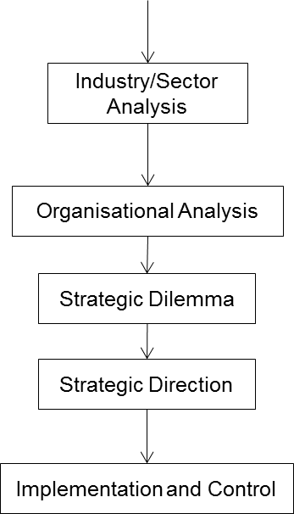
Macro Level Analysis
PESTEL
Political
Macro Analysis
Economic
Sustainability
Technology
Environment
Legal

Slide 16
Macro Analysis - PESTEL
Political
Strategists need to understand these stakeholders:
Politics, e.g. Left, Right Wing
How the economy is organised, e.g. manufacturing, service, hospitality, growth
Social, e.g. social capital, family violence, mental health
Environment, e.g carbon reporting
Legal instruments, Acts. Laws
Economic
Social
Technology
Environment
Legal

Slide 17
Industry/Sector Analysis
Macro Analysis
Porter’s Five Forces of Competition
Industry/Sector Analysis
Threat of Entrants
Organisational Analysis
Threat of Substitutes
Strategic Dilemma
Bargaining Power of Suppliers
Strategic Direction
Bargaining Power of Buyers
Implementation and Control

Slide 18
Porter’s Five Forces of Competition
Threat of Entrants
New entrants to an industry bring new capacity and their desire to gain market share that puts pressure on prices, costs and the rate of investment necessary to compete.
Bargaining Power of Suppliers
Powerful suppliers capture more of the value for themselves by charging higher prices, limiting quality or services, or shifting costs to industry participants.
Threat of Substitutes
A substitute performs the same or a similar function as an industry’s product by a different means.
Bargaining Power of Buyers
Powerful customers – can capture more value by forcing down prices, demanding better quality or more service

Slide 19
Organisational Analysis
Macro Analysis
Industry/Sector Analysis
Resource Based View
Organisational Analysis
Valuable
Rare
Strategic Dilemma
Inimitable
Strategic Direction
Non-substitutable
Implementation and Control

Slide 20
Organisational Analysis – Resource Based View
Barney's (1991) VRIN framework to determine if organisational resources provide sustainable competitive advantage.
To serve as a basis for sustainable competitive advantage, resources must be --
Valuable - meaning that they must be a source of greater value, in terms of relative costs and benefits, than similar resources in competing firms
Rare -- rareness implies that the resource must be rare in the sense that it is scarce relative to demand for its use or what it produces
Inimitable -- it is difficult to imitate
Non-substitutable -- other different types of resources cannot be functional substitutes
Macro Analysis
Industry/Sector Analysis
Organisational Analysis
Strategic Dilemma
Strategic Direction
Implementation and Control

Slide 21
Strategic Dilemma
Macro Analysis
Industry/Sector Analysis
Generic Models
Organisational Analysis
Porter
Miles & Snow
Strategic Dilemma
Market Focus
Typology
Prospector
Differentiation
Strategic Direction
Defender
Cost
Analyser
Implementation and Control
Reactor

Slide 22
Miles & Snow Typology
Defenders: Organizations that seek to develop efficiencies within a stable environment in order to defend their position in the market against potential competition
Prospectors: Organisations that are constantly seeking new markets and opportunities to enter, these type of organisations tend not to develop complete efficiencies and profitability however is very adaptive to a changing environment.
Analysers: Analysers choose a balance between the Defender and Prospector Strategy. Not adopting any new opportunities or markets until it is proven to be lucrative and in the meanwhile attempting to increase their efficiency as much as possible
Reactors: Reactors are organisations that fail to develop consistent strategies for dealing with and adapting to the changing environment

Slide 23
Strategic Dilemma for Organisations
Which strategy model is applicable for contemporary organisations?
Which strategy type do you think you are following?
Which strategy are you actually practicing?
Which strategy model do you want to achieve?
Generic Models
Porter
Miles & Snow
Market Focus
Typology
Prospector
Differentiation
Defender
Cost
Analyser
Reactor

Slide 24
Managing strategically …

Slide 25

Managing Strategically
We want to think differently
Innovation
Creativity
Learning
Social / Organisational learning
Image source: Google Images; www.skillpath.com

Slide 26
Managing Strategically – Creating the Leverage
Organisational Analysis
Subjective
Thinking Point – Organisations have access to the same tools
What will offer competitive advantage?
Social
Learning/ Institutionalisation
Knowledge
Communities
Power /Inequality

Slide 27
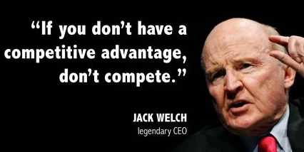
What is Competitive Advantage?
People do not act in a mechanical, predictable, objective or unemotional ways.
Innovative
Learn
Creative
Critical thinkers
Image source: Google Images: www.constructionmarketing.org

Slide 28
Managing Strategically
Leveraging the Strategic
Learning/ Institutionalisation
Knowledge
Communities of Practice

Slide 29
The ‘learning’ organisation…

Slide 30
Learning/ Institutionalisation
As strategy, we need to consider how an organisation learns – because this often leads to new behaviours and practices in organisations.
Social structure:
Relatively stable patterns of social behaviour.
Routinised and institutionalised social behaviours that enable and constrain individual action and yet is the product of that action.
Thinking Point:
Are social structures in organisations “tangible”?

Slide 31

How do Organisations Learn?
Organisations as shared understanding:
of how people create local meaning
of how this meaning is interpreted and reproduced
of shared interests, practices and identities
of mutual learning
of improvised social interactions
Zucker, L. G. (1977). The role of institutionalization in cultural persistence. American sociological review, 726-743.

Slide 32
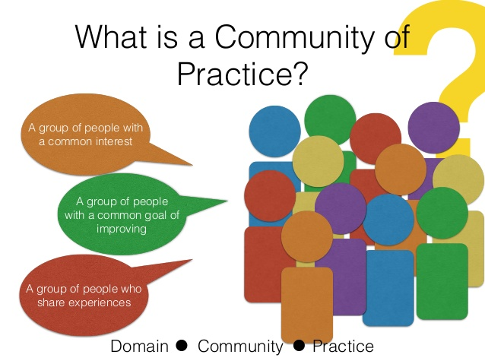
Managing Learning: Communities of Practice
Communities of practice are groups of people who share a concern or a passion for something they do and learn how to do it better as they interact regularly.
Wenger (2011)
Source: Google Images: www.slideshare.net

Slide 33
Understanding Communities of Practice
Managing their Strategic Value in Organisations
Understand that communities are not limited by formal structures
they create connections among people across organisational and geographic boundaries.
Participants develop a shared repertoire of resources: experiences, stories, tools, ways of addressing recurring problems
Participants value their collective competence and learn from each other

Slide 34
Managing Communities of Practice
Communities of Practice as Strategic Advantage
People outside the group may value or even recognise the shared expertise.
A growing number organisations in various sectors are now focusing on communities of practice as a key to improving their performance.
Communities of practice are key to improving performance as “Organizational Memory”

Slide 35
Promoting Communities of Practice
Strategy for replicating organisational success
Steering group, strategy and project plan, resource requirements
Create diversity
Justifying corporate investment
How to manage success and popularity
How to earn trust of executives (ingratiation)
Corporate communication
Technology supports communities of practice

Slide 36
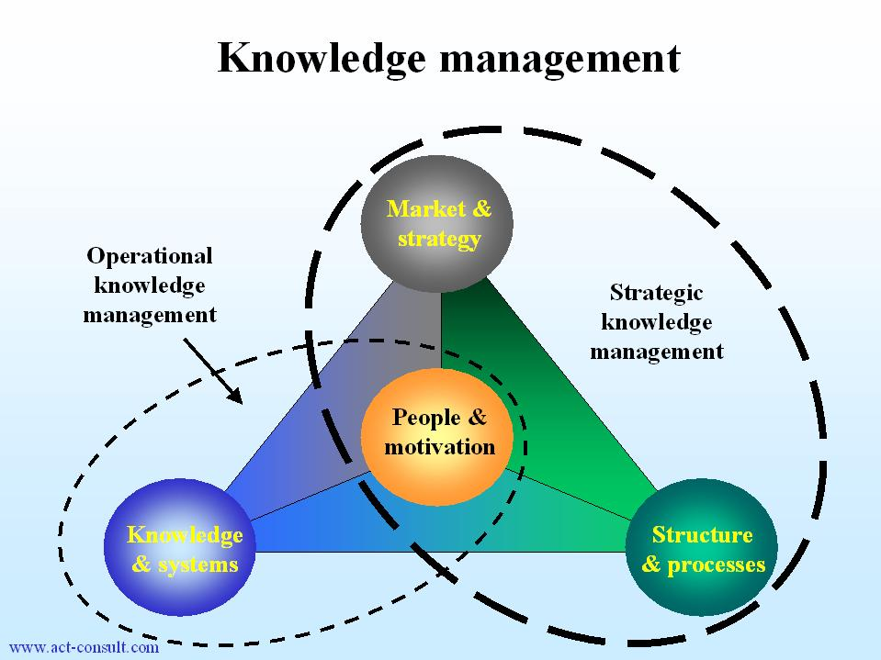
Managing Knowledge Strategically
Managers need to understand:
How do people learn?
What are their assumptions?
Is knowledge subjective or objective?
How do organisations learn?
How do you capture this value?
Image source:
Google Images: knowledgemanagement-review.blogspot.com

Slide 37
Tutorial Exercise
Give an example of how you have learnt “what to do” at RMIT
Did you learn this through observation?
How will you pass this “knowledge” on?
How might it lead to the development of new strategy?

Slide 38
References
Hill, C, Jones, G, and Schilling, M, 2015, Strategic management theory, 11th edn, Cengage, Stamford, CT
Lockett, A., Thompson, S., & Morgenstern, U. (2009). The development of the resource‐based view of the firm: A critical appraisal. International Journal of Management Reviews, 11(1), 9-28.
Porter, M. E. (2008). The five competitive forces that shape strategy.
Robbins, SP, DeCenzo, DA, Coulter, Mand Woods, M (2016) Management The Essentials 3e, Pearson, Melbourne (Chapter 4 & 6)
McDaniel, S. W., & Kolari, J. W. (1987). Marketing strategy implications of the Miles and Snow strategic typology. The Journal of Marketing, 19-30.
Wenger, E (2011). Communities of practice: A brief introduction.

Slide 39
Human Perspectives
1.Foundations of Management practices
2. Managing OB: Foundations
Organisational Perspectives
6. Leadership
7. Managing strategically
8. Organisational analysis
International Perspectives
10.
Global society
11. Future Trends
3. Managing OB: Groups & teams
12. Review
4. Managerial communication
5. Managing ethical behaviour
9. Innovation, creativity & design
Next class...
Introduction to Management

